Slide 1
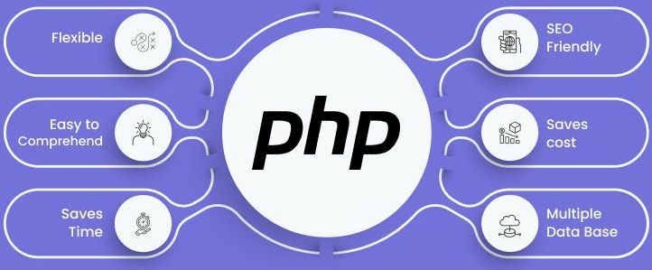

Slide 2
About today…
Login System

Slide 3
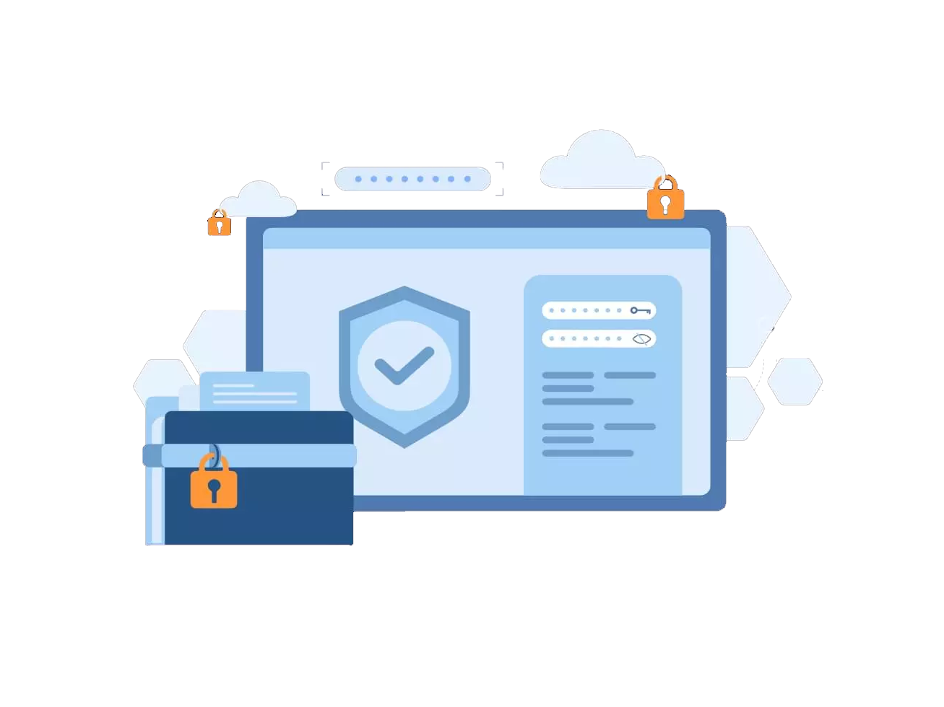
Login System

Slide 4
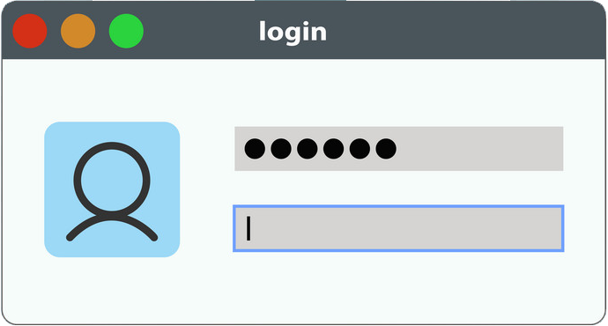
Introduction to Login System
Objective
Blend authentication, authorization, session management, and cookies into a cohesive login system
Outcome
Implement a secure, user-friendly login system

Slide 5
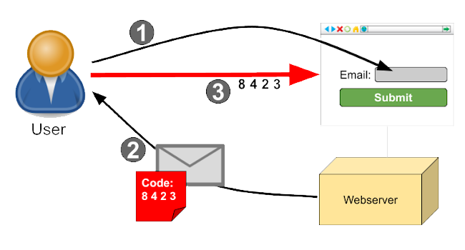
System Architecture Overview
Client
Browser (User Interface)
Server
Backend (Node.js/Express)
Database
User data storage (e.g., MongoDB)
Communication
HTTPS for secure data transmission

Slide 6

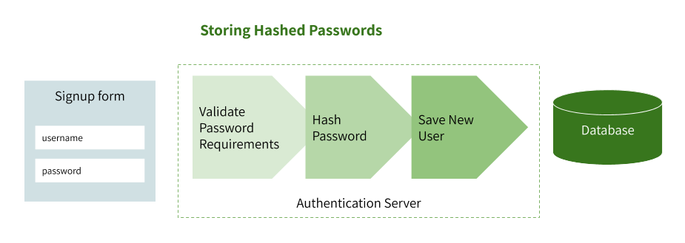
User Registration Workflow
User Input
Collect username and password
Data Validation
Ensure input meets criteria (e.g., password strength)
Password Hashing
Securely hash the password using bcrypt
Database Storage
Save user credentials in the database

Slide 7
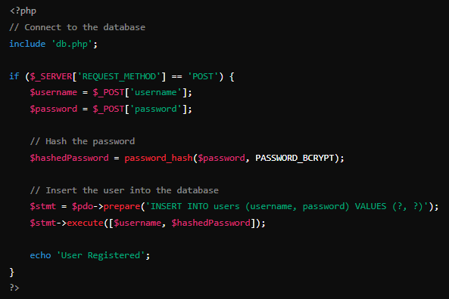
Code Example : User Registration

Slide 8
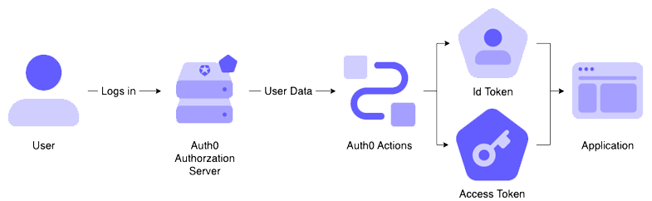
User Login Workflow
User Input
Collect username and password
Credential Verification
Compare input password with hashed password in the database
using password_verify()
Session Creation
Start a PHP session
Cookie Storage
Store session ID in an HttpOnly, Secure cookie

Slide 9
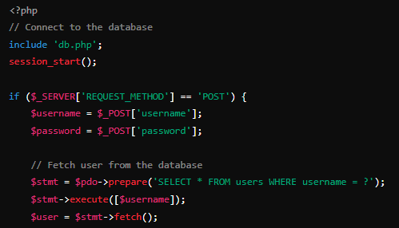
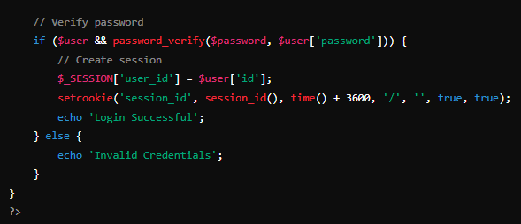
Code Example : User Login

Slide 10
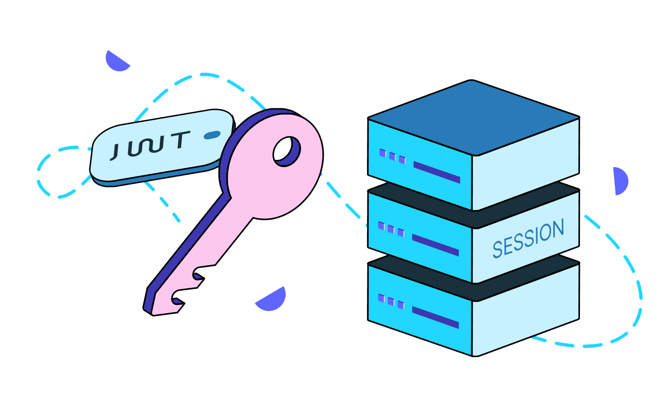
Session Management
Session ID
Unique identifier for each user session
Storage
Managed by PHP's $_SESSION superglobal
Storage
Set session timeout to enhance security
Renewal
Option to renew session before expiry

Slide 11
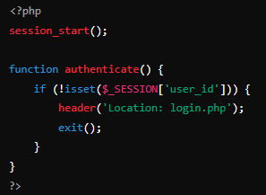
Middleware for Protected Routes
Purpose
Protect routes and ensure only authenticated users access
specific resources
Session Verification
Check if a valid session exists

Slide 12
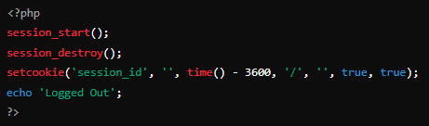
Logout Functionality
Invalidate Session
Destroy the session data
Clear Cookies
Delete session cookie from the user's browser

Slide 13
Enhancing Security
HTTPS
Encrypt data in transit
Password Policies
Enforce strong passwords
Rate Limiting
Prevent brute force attacks
Session Timeout
Automatically expire inactive sessions

Slide 14


Slide 15

What is the primary purpose of hashing passwords in a login system?
To store passwords securely
Why is it important to use prepared statements in PHP for login systems?
To protect against SQL injection attacks
Which of the following is a key benefit of using HTTPS on a login page?
Protection against eavesdropping
Which function in PHP is used to regenerate a session ID?
session_regenerate_id()

Slide 16

Task 1
Create a webpage to enhance the security of a PHP login system by implementing password hashing and using prepared statements

